Slide 1
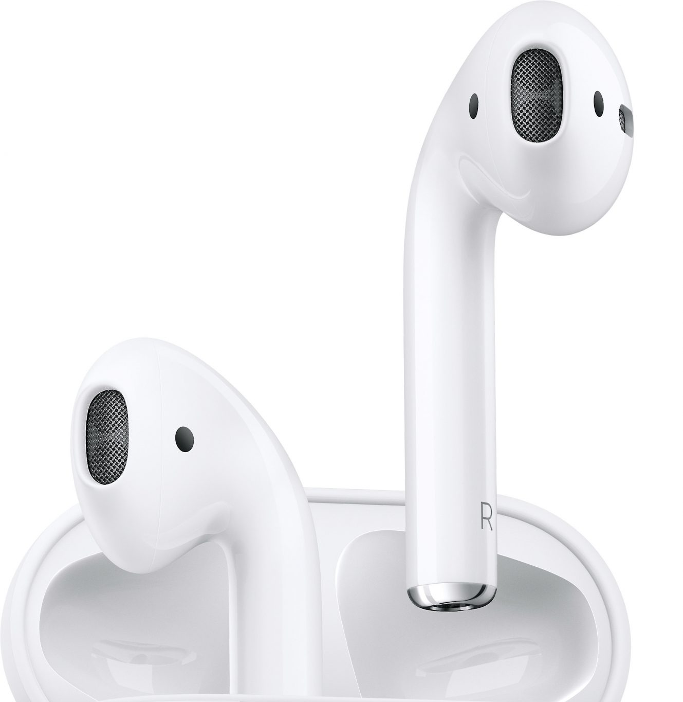
AIRPODS
Michael Serrano
This Photo by Unknown Author is licensed under CC BY-SA-NC

Slide 2
Table of Contents
Target Market
SWOT Analysis
Product
Price
Place
Promotion

Slide 3
Target Market
Demographic
Young People Dominate the Airpods Market
Toward Data Science found that 60% of 89 Respondents are Young
Males are more likely than Females
Most are College Level Students
Geographic
United States and Other Western Countries
Largest Market
Psychographic
Focuses on Emotion

Slide 4
Types of Consumer
Owners of a Previous Apple Product
Company Reliability on Top of New Product
Looking for an Upgrade of Bluetooth Headphones
Sleek Design Coupled with New Features
First Time Bluetooth Headphone Buyers
Looking to get rid of Wired Headphones

Slide 5
SWOT Analysis
 | Positive | Negative
Internal | Strengths Cheap Compared to Competition Looks Clean Bluetooth Headphones | Weaknesses Lack of Specs Doesn’t Always Fit Ear Too Expensive for Low Income
External | Opportunities Upgraded Variations Bigger Specs Custom Airpods(Colors) | Threats Competition Could Make Their Own Cheap Knockoffs

Slide 6
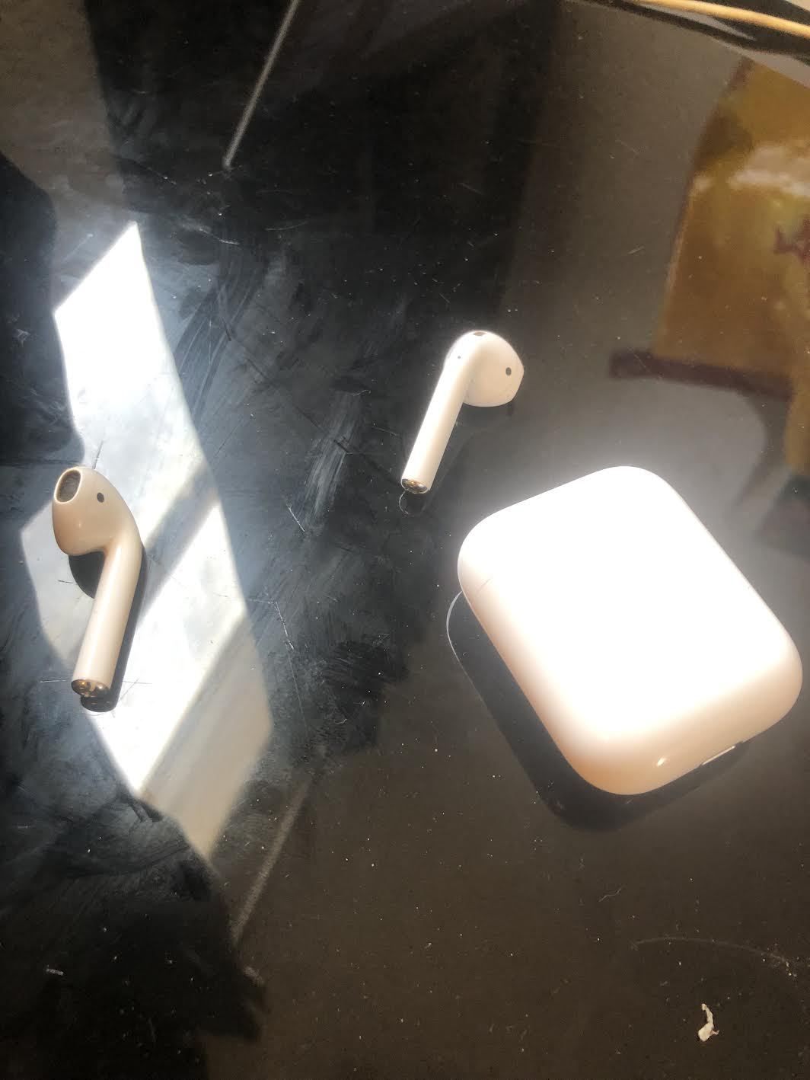
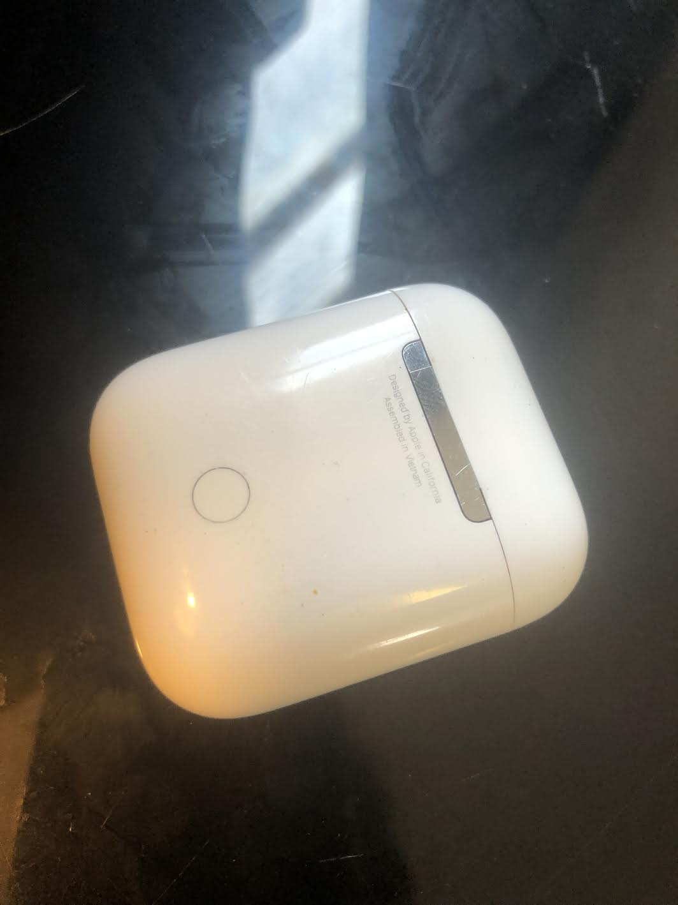
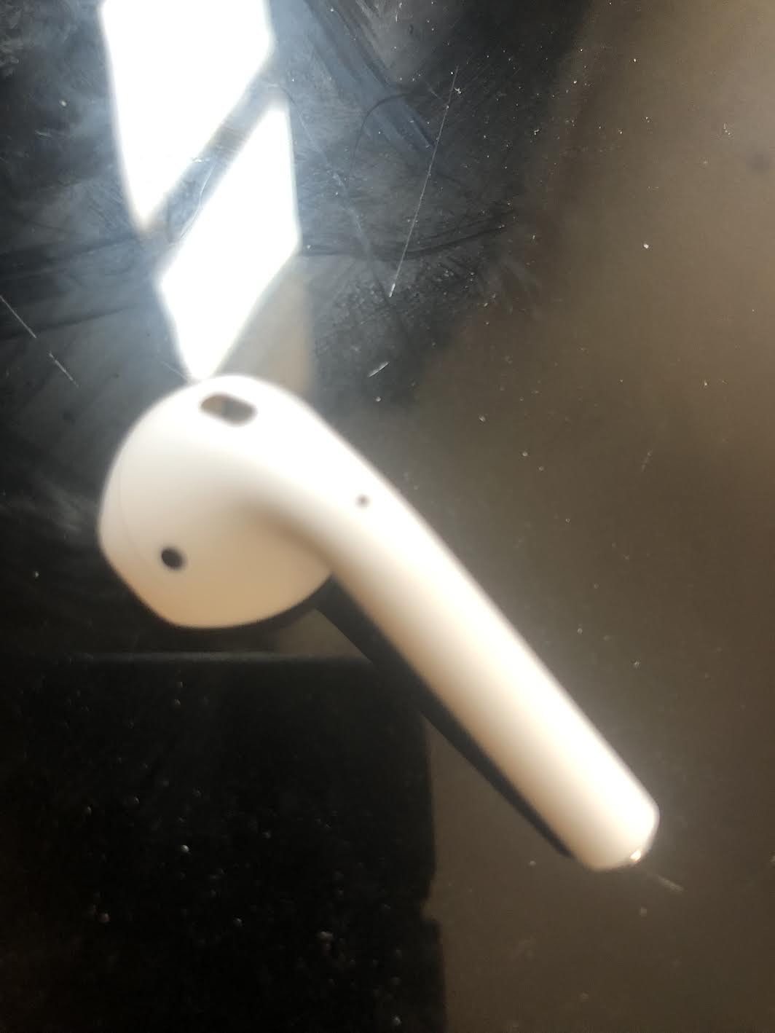
Product Description
What Does it Look Like?
Small (Size: Airpods (each) 0.65 x 0.71 x 1.59 in (16.5 x 18.0 x 40.5 mm)
A Basic White Outline with Black inner earbud design

Slide 7
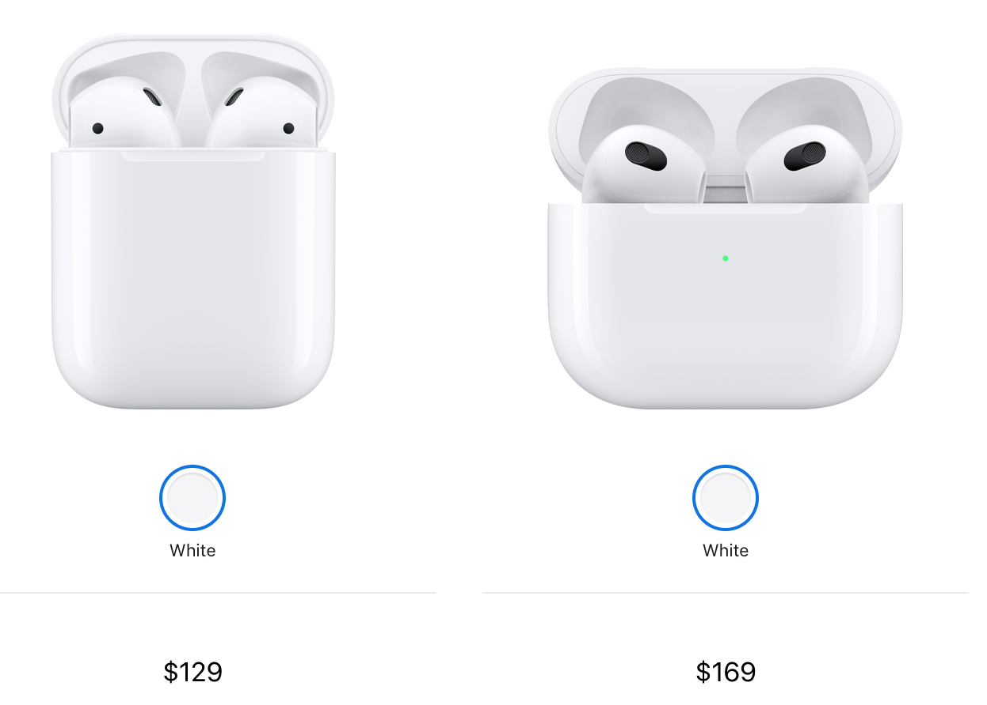
Other Variation
Apple Airpods Second Generation
Better Audio and Voice Quality
Supports Siri
Apple Price: $129
Amazon Price: $114
Apple Airpods Third Generation
Spatial Audio
Updated Design
Apple Price: $169
Amazon Price: $169.99

Slide 8
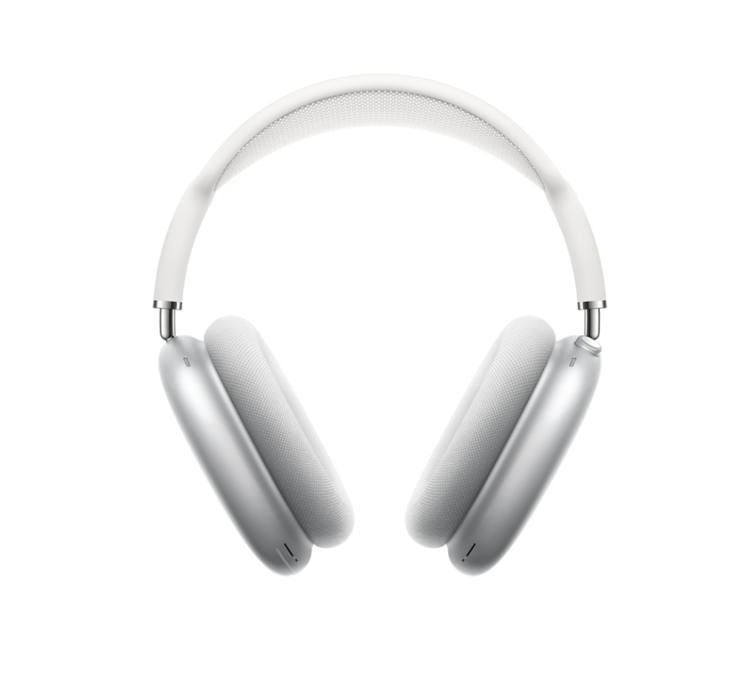
Upgraded Variations
Apple Airpods Pros
Noise Canceling
Spatial Sound
Real World Siri Control
Apple Price: $180
Amazon Price: $167
Apple Earphones Max
First Over-ear
20 Hour Battery
Apple Price: $549
Amazon Price: $449

Slide 9
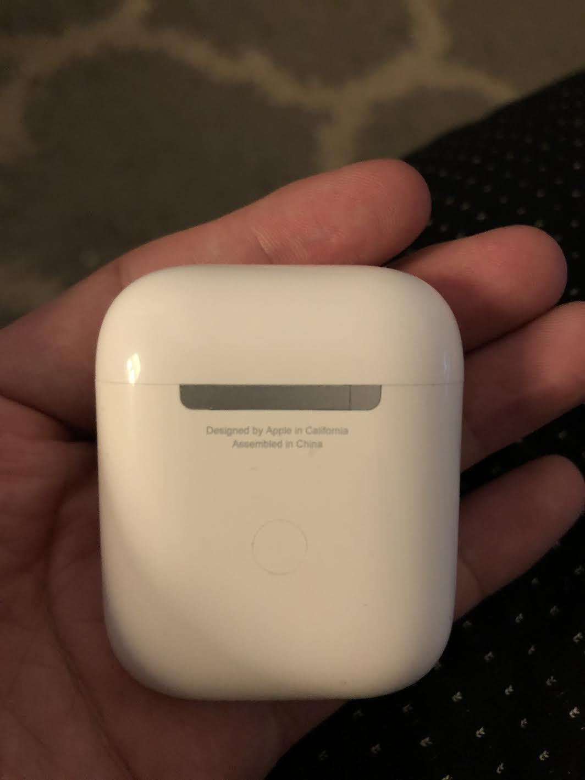
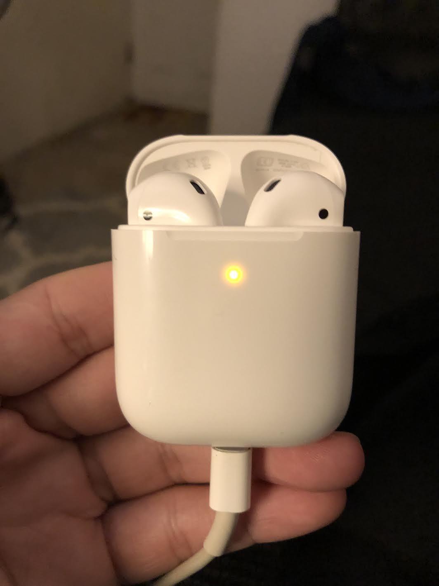
Fake Airpods
Usually sold by eBay, Amazon, and Small Online Stores
Designed Same as the Airpods
Difference in Serial Number, Model Number and Firmware
Price: $80-$120

Slide 10
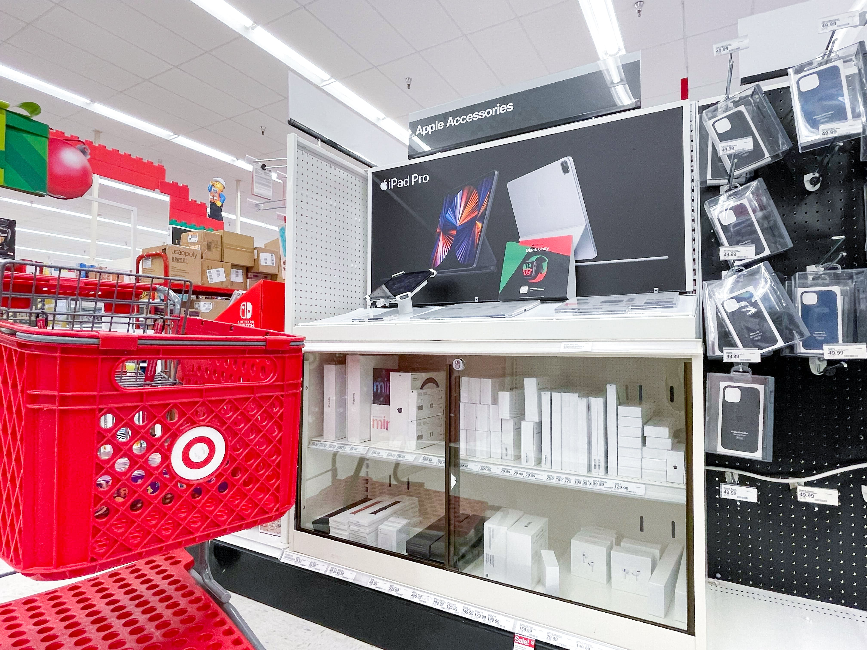
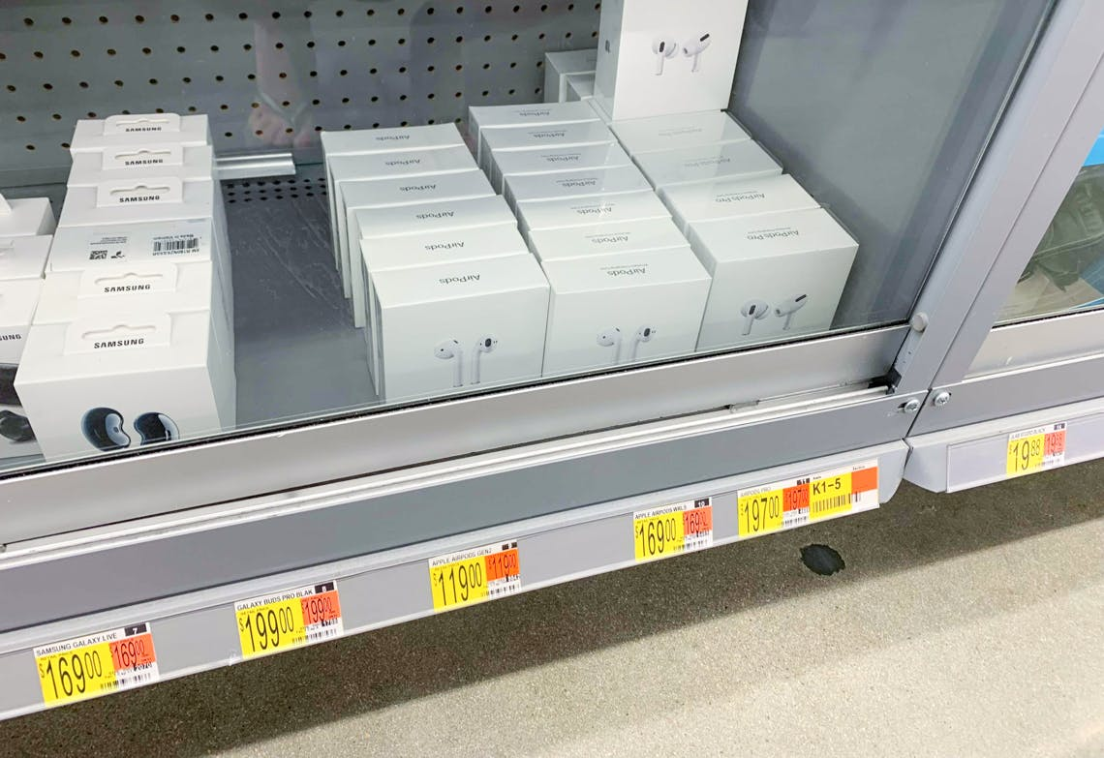
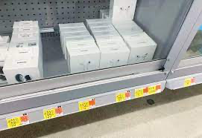
Place
Apple Store
Instore
Verizon
Target
Walmart
Online Realtors
Amazon
eBay
BestBuy

Slide 11
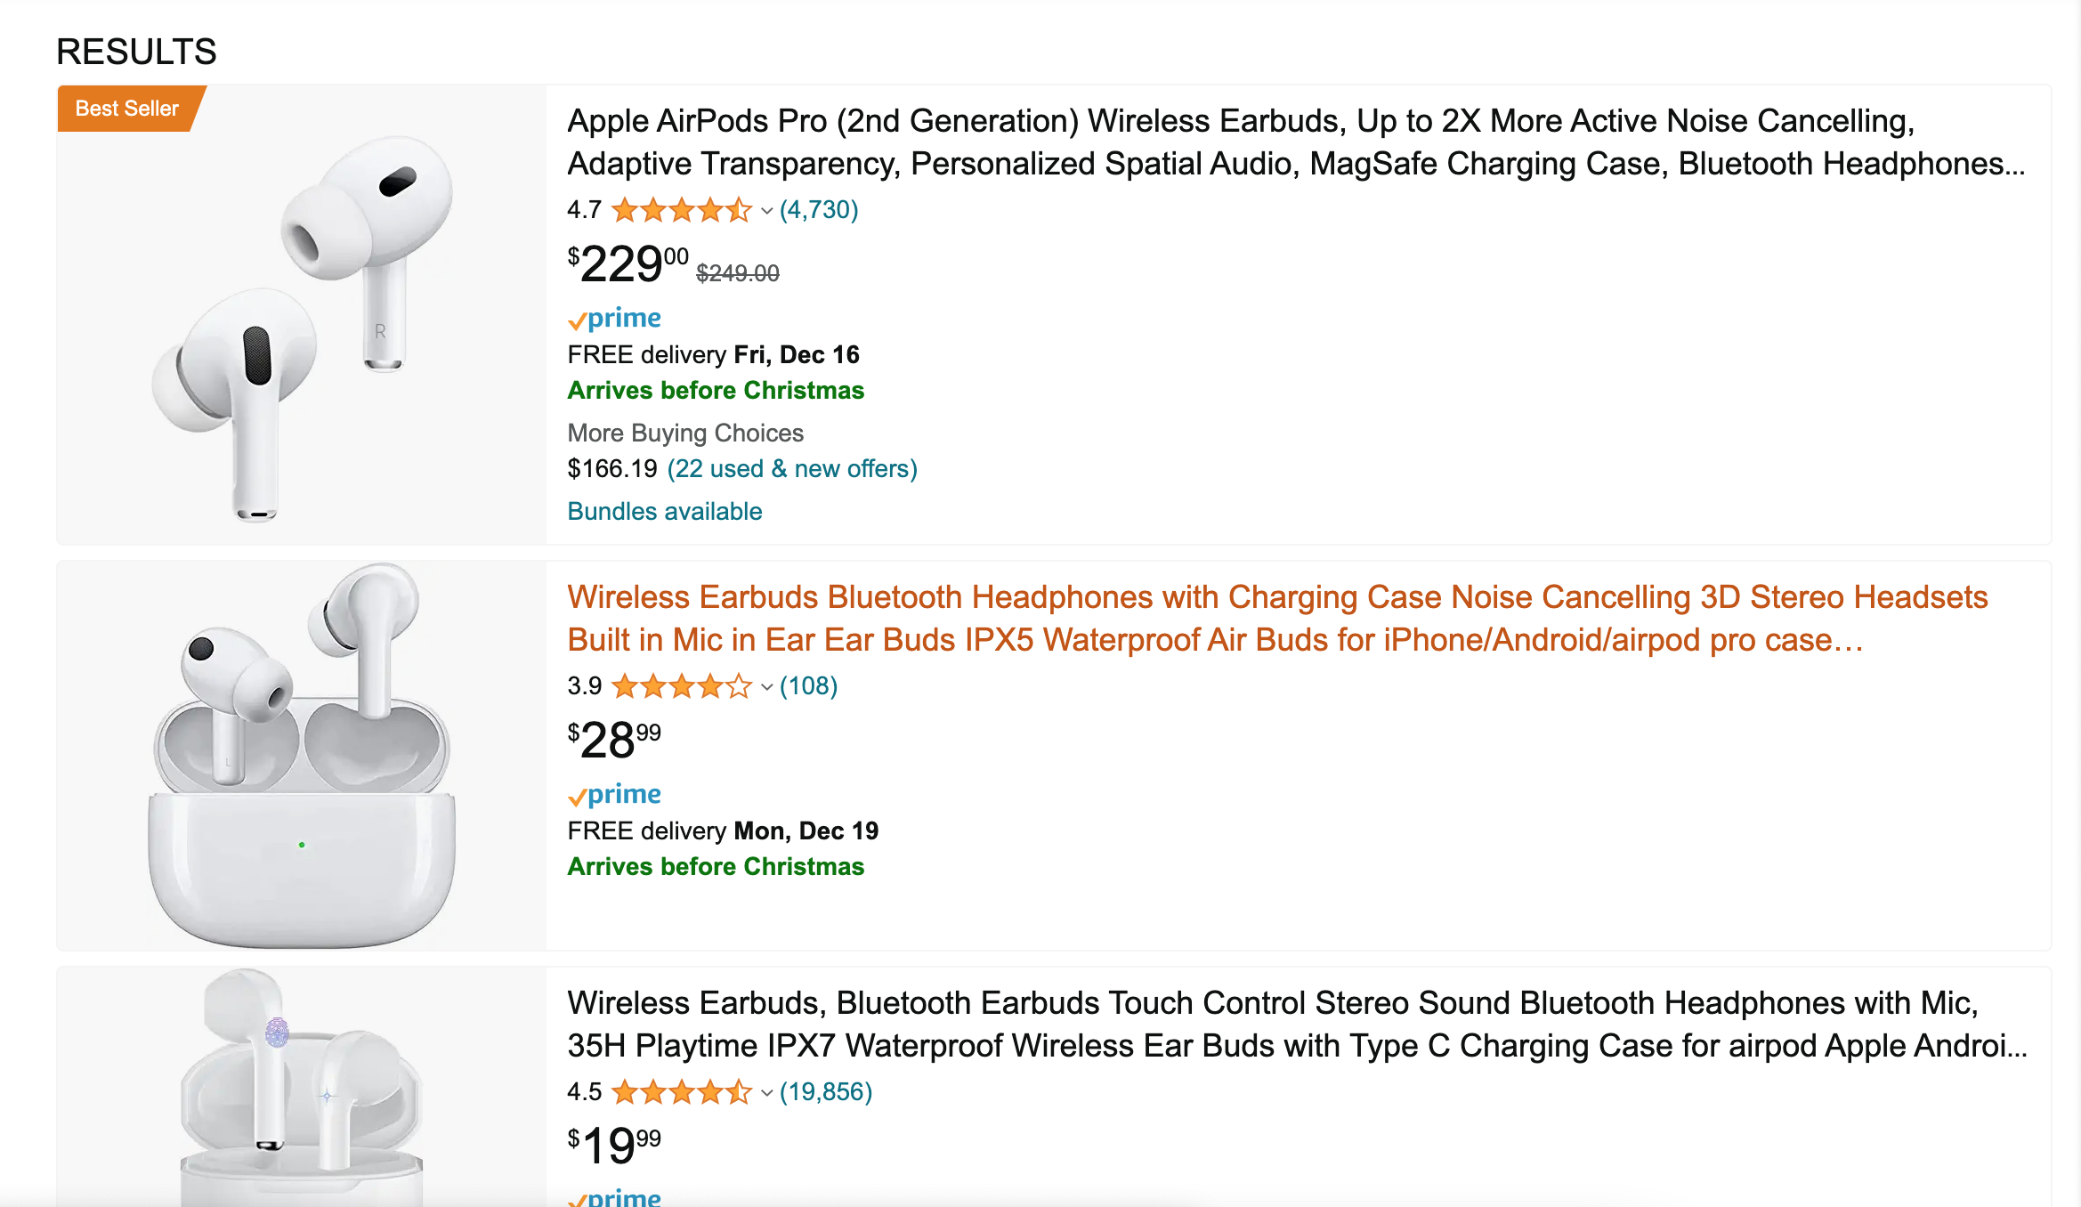
Online
Major Realtors
Walmart
Target
BestBuy
Small Chain Stores
Weird Places
Like Etsy or an Antique Store

Slide 12
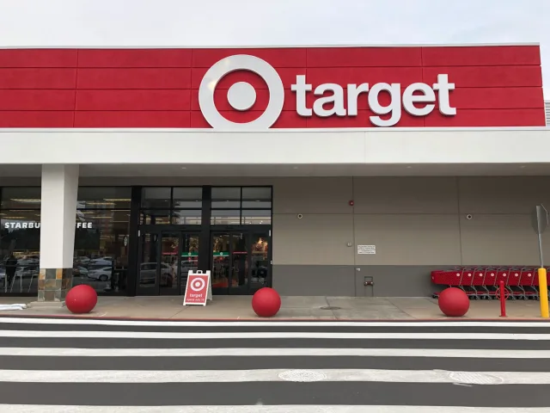
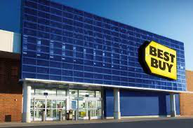
Instore
Target
Price:$129.99
BestBuy
Price:$119.99
Verizon
Price:$129.99
Walmart
Price:$119

Slide 13
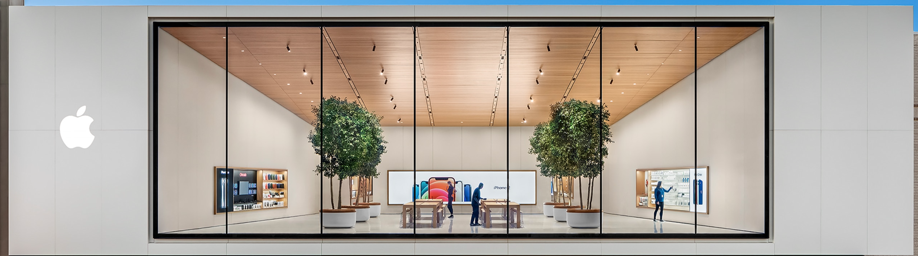
Different Locations
Located in Apple Store
Different Designs for Different Locations
100 Different Countries

Slide 14
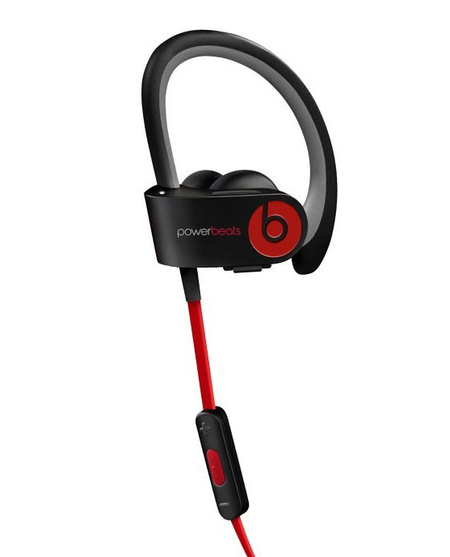
Price Based on Competition
Beats Over-ear Headphones
Price: $349.99
Beats Powerbeats
Price: $138
Bragi the Dash
Price: $349.99
Sony Noise Cancelling
Price: $248

Slide 15
Price Strategies
Affordable for Consumer
Cheap Compared to Competition at the Time
Sleek, New
The design was sleek and new
No small and customer focused Bluetooth earphones
Designed By Apple
Apple is a very dependable company

Slide 16
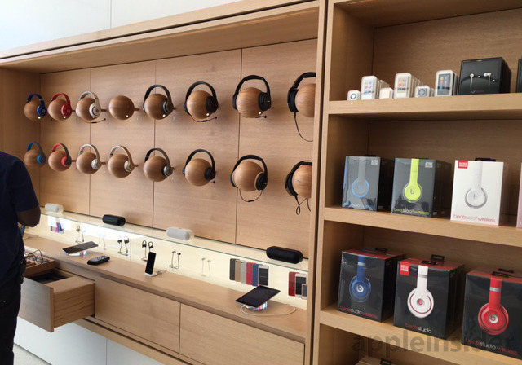
Store Displays
Airpods located on a wooden display
Capable of using the products in store
Products on Mannequin

Slide 17

Promotional Ads
TV/YouTube ads
Apple Promo
Magazines
Techworld
Wired
Shows
Conan

Slide 18
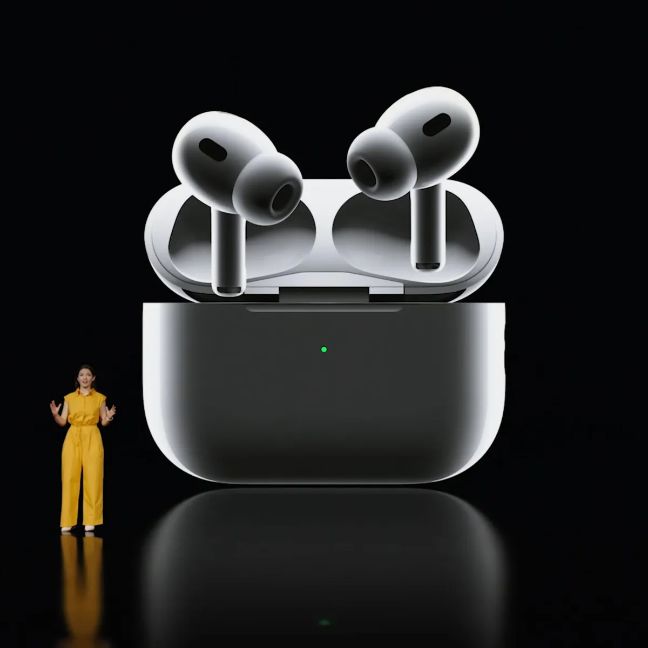
Location of ADs
Cable TV
YouTube
WWDC
Special Events
Social Media
Twitter
Facebook

Slide 19
Conclusion
Young, First Time Buyers tend to be the focus of Airpods
Offering Many Variations
Airpods Offer a Cheap Alternative to High Priced Earphones
Many Promotional Ads Online
Designed by a Trustworthy Company, Apple

Slide 20
Sources
Nguyen, D. (2021, April 29). Analyzing customer satisfaction of Apple airpods using exploratory data analysis and... Retrieved December 9, 2022, from https://towardsdatascience.com/analyzing-customer-satisfaction-of-apple-airpods-using-exploratory-data-analysis-and-50622292e5dd
7.1.1. psychographic. (2012, January 06). Retrieved December 9, 2022, from https://appleanalyses.wordpress.com/7-1-1-psychographic/
Gilbertson, C. (2022, November 02). Apple Black Friday deals now at Target - prices start at $85.49. Retrieved December 9, 2022, from https://thekrazycouponlady.com/2022/11/01/apple-black-friday-deals-now-at-target-prices-start-at-85-49
Amazon. (n.d.). Retrieved December 9, 2022, from https://www.amazon.com/airpods/s?k=airpods

